Slide 1

Mini-Project-11A T.E. (Computer) Sem - V
 | Agnel Charitie’s Fr. C. Rodrigues Institute of Technology, Vashi Department of Computer Engineering
2023-24

Slide 2
EcoDoc
Group members:11A
Shruti Deshpande 1021129
Shruti Katkar 1021158
Sheryl Konuparamban 1021160
Mansi Kumbhar 1021162

Slide 3
Presentation Outline
Abstract
Introduction
Literature Survey
Existing System
Proposed System
Conclusion
References

Slide 4
ABSTRACT
A paperless office is an ecosystem of work in which the use of paper is reduced to a large extent.
The paperless office solution is a modern approach to digitizing and streamlining document management processes within organizations.
Aims to eliminate or reduce the use of paper by implementing electronic document storage, retrieval, and collaboration systems.
Leveraging technologies such as cloud storage, electronic signatures, and workflow automation to improve efficiency, reduce costs, and enhance environmental sustainability.

Slide 5
INTRODUCTION
Background
In today's fast-paced and technologically-driven world, the concept of a paperless office has gained significant traction as a approach to revolutionize document management processes.
This solution aims to reduce or eliminate the reliance on traditional paper-based documentation by harnessing the power of cutting-edge technologies.
Through the implementation of electronic document storage, retrieval, and collaboration systems, businesses can streamline their operations, boost efficiency, and bolster environmental sustainability.

Slide 6
INTRODUCTION
Motivation
The motivation behind the paperless office project stems from several key factors:
Environmental Impact: Traditional paper-based processes contribute to deforestation and waste generation. Adopting digital alternatives reduces the environmental footprint of office operations.
Efficiency and Productivity: Paper-based workflows are often slower and prone to errors. Digital processes enable faster information sharing, seamless collaboration, and automation of routine tasks, thereby boosting overall productivity.
Space Optimization: Storing paper documents requires physical space, which can become cluttered and challenging to manage. Digitizing documents eliminates the need for physical storage.
Accessibility and Remote Work: Digital documents can be accessed from anywhere with an internet connection, facilitating remote work, telecommuting, and global collaboration.

Slide 7
INTRODUCTION
Aim & Objective
The aim of the Paperless Office Project is to transition from traditional paper-based workflows to a digital, efficient, and sustainable office environment.
It aims to, Reduce Environmental Impact, Improve Efficiency, Enhance Accessibility, Enhance Security, Collaboration, Backup and Disaster Recovery, Scalability.
By leveraging the full potential of technologies such as cloud storage, electronic signatures, and workflow automation, organizations can usher in a new era of enhanced productivity, cost reduction, and a greener ecological footprint.
This project seeks to eliminate or significantly reduce the use of paper documents and replace them with digital alternatives.

Slide 8
LITERATURE SURVEY
Pursuing the possibility of a paperless office Stratton A.
Idea mentioned in the paper
The difficulties that businesses are facing during paperless implementations are discussed in this article.
The creator centers around workers turning into the hindrance when new cycles or innovation are acquainted with the association.
The author points out that, in many businesses, employees are given access to brand-new technology with little instruction, examples, or training.

Slide 9
LITERATURE SURVEY
How safe are your digital documents? Mills-Senn
Idea mentioned in the paper
Describes how electronic records the board (ERM) arrangements assist associations with defeating their paper stockpiling issues.
Gives strategies and methods that empower associations to execute and use an ERM framework effectively.
Significantly reduce paper flow through the use of electronic documents/records management and imaging solutions.
Technology/tool used
ERM framework.

Slide 10
LITERATURE SURVEY
Document Management System: Mahendra K. Ugale
Idea mentioned in the paper
This article covers some of the advances in technology that aid professionals in shifting to a paperless business future.
Digital document organization to search and store documents while minimizing paper usage.
This paper explains many stages for processing various documents utilizing scanning, tagging, and indexing for optimal data retrieval using OCR and Indexing techniques.
Technology/tool used
DMS based on digital document organization to search
and store documents.
OCR for data retrieval.

Slide 11
LITERATURE SURVEY
Going paperless - on the evaluation of electronic form technologies, Lutteroth, C. & Weber, G.
Idea mentioned in the paper
The authors identified the following requirements that must be met for
electronic forms to be successful:
Authentication and authorization
Pre-population of forms based on identity
Basic validation
Usability and accessibility
Digital signature and auditability
Ease of creation

Slide 12
LITERATURE SURVEY
Table of Comparison/summary
Paper Title | Author | Idea presented
Pursuing the possibility of a paperless office | Stratton A. | Difficulties that are faced during paperless implementations as employees are given access to technology without training.
How safe are your digital documents? | Mills-Senn | Use of Electronic records the board (ERM) arrangements to defeat paper stockpiling issues.
Document Management System | Mahendra K. Ugale | Use of Document Management System to search and store documents, OCR and Indexing techniques.
Going paperless - on the evaluation of electronic form technologies | Lutteroth, C. & Weber, G. | Requirements that must be met for electronic forms to be successful.

Slide 13
EXISTING SYSTEM
Paperless Onboarding Platform(pop)
Idea
It is a special versatile app based on computerized onboarding and report accommodation stage.
This empowers the client to come on board with zero administrative work, altogether lesser exertion in structure filling and reduce around 50% of the first time that it required before to finish the whole cycle.
The main advantage of this app is that verification process and fetching of required documents becomes easier..
Drawbacks
The camera quality and scanning process are not up to the mark

Slide 14
EXISTING SYSTEM
Dropbox
Idea
This is a technique for individual distributed storage.
Dropbox enables users to share files with coworkers and friends in addition to storing them.
You can store records, pictures, recordings also, introductions in Dropbox.
Dropbox makes it easy to share files.
It provides back up for all the files.
Drawbacks
Security concerns prevail as there is no encryption performed before uploading .

Slide 15
EXISTING SYSTEM
Notion
Idea
Notion started out as a note-taking app, but its now a project management tool for small businesses and solopreneurs.
It is a brilliant device for keeping all venture related data in a single spot, building work processes rapidly and sharing.
Advantages: Simple to use and reasonable pricing
Drawbacks
Security is not assured and it is difficult to manage multiple projects .

Slide 16
EXISTING SYSTEM
Google Workspace
Idea
Google Work Space incorporates elements to share schedules, notes and reports, as well as the capacity to hold gatherings and store and oversee archives.
Google Work Space allows associations to add custom marking to their work areas and incorporates work process robotization apparatuses, reporting and analytics , and adaptable layouts.
The applications provides high level of security .
Drawbacks
Google Workspace is generally less expensive than other productivity suites, it may still be seen as too costly for some small businesses or individuals.

Slide 17
EXISTING SYSTEM
Table of Comparison/summary
Existing System | Technology Stack used | Features Supported | Gap Identified
Paperless Onboarding Platform(pop) | React JS Flask | Share files. Store records, pictures, recordings, etc. | Poor camera quality and scanning process.
Dropbox | React JS Python Amazon Web Services Flask | File Storage and Sharing, File Synchronization, File Comments and Notifications | Security concerns due to no encryption.
Notion | React JS WebSocket Amazon Web Services | Note-Taking and Documentation, Team collaboration. | Security is not assured. Difficult to manage multiple projects.
Google Workspace | Google Cloud Platform JavaScript AJAX Different Google Services | Share schedules, notes and reports, hold gatherings and store and oversee archives. | Expensive for small scale business.

Slide 18
PROPOSED SYSTEM
The system proposed is a paperless office software. A collaborative tool for paperless functioning of offices according to the need organization.
This tool will enable users to store, access, share and approve documents, conduct
Features:
Document Management
Scanning and Digitization
Collaboration Tools
Security and Access Control
Workflow Automation
Integration with Existing Tools
Environmental Considerations

Slide 19
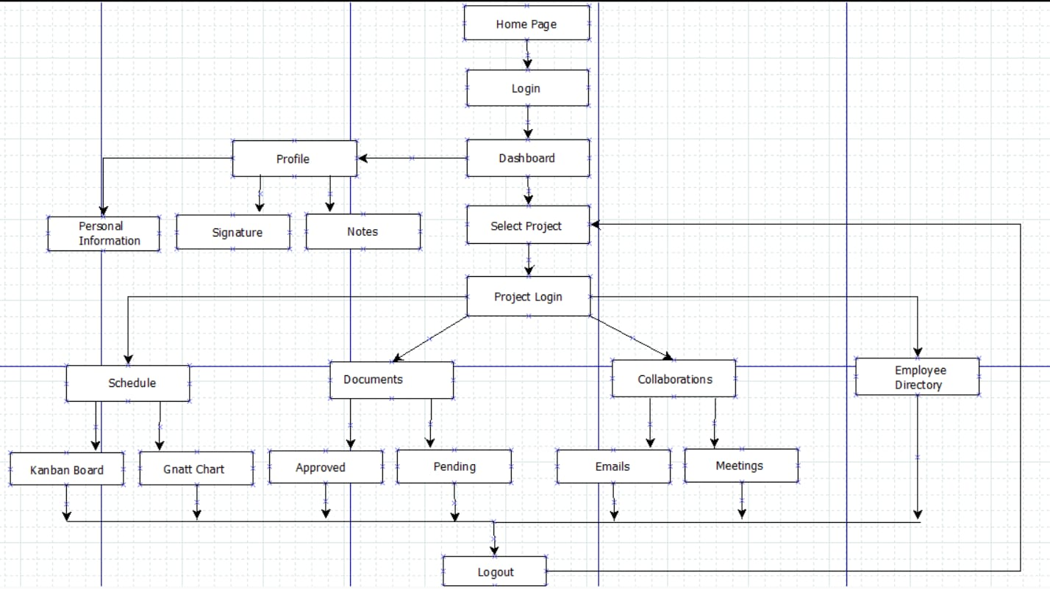
DESIGN

Slide 20
CONCLUSION
In conclusion, the implementation of a paperless office project offers numerous advantages, such as increased efficiency, reduced environmental impact, enhanced data security, and improved accessibility.
By transitioning from traditional paper-based processes to digital workflows, organizations can streamline document management, boost productivity, and save costs associated with printing and storage.
Moreover, the shift towards a paperless office aligns with sustainability goals by reducing paper consumption and promoting a more eco-friendly work environment.
Overall, the move towards a paperless office represents a progressive step towards modernizing and optimizing office operations in today's digital age.

Slide 21
REFERENCES
Agade, S., Gokhe, S., Chilamkar, P., Gurnule, U., & Zade, P. S. D. (2020, February). Document Digitalization through use of Cloud Computing Technology. International Journal of Engineering Applied Sciences and Technology (IJEAST), 4(10), 260-262.
Arinze, B., & Anandarajan, M. (2010). Factors that determine the adoption of cloud computing:
A global perspective. International Journal of Enterprise Information Systems, 6(4), 55-
68. http://dx.doi.org/10.4018/jeis.2010100104
Dykman, C. A., & Davis, C. K. (2012). Addressing resistance to workflow automation. Journal
of Leadership, Accountability & Ethics, 9(3), 115-123.
academia.edu/45784406/A_Review_of_The_Challenges_of_Paperless_Concept_in_the_Society_5_0
Shifter, A., & Gerber, D. (2007, March). Getting real about the paperless office: Improving
service and efficiency by reducing paper use. Benefits & Compensation Digest, 44(3),
38-43.
Stratton, A. (2013). Pursuing the possibility of a paperless office. Information Management
Journal, 47(5), 44-46.

Slide 22
Thank You!

